Slide 1
IAM Group Services
April 25, 2018 | Overview Presentation | IAM Group Services

Slide 2
Groups Enable Other IT Services
Groups are a critical component of these IT Services
Access Control (available now) | Enable application access for eligible users (authorization) Authorization options through HarvardKey & API Automatically removes access as eligibility ends
Communication (start in FY19) | Email or texting messaging to targeted audiences Broadcast Communications
Collaboration (future) | Simplify document sharing to collaborators Enable controlled file sharing (individuals and groups)
Notes:
The power of the group is not in its existence but in how it is used.

Slide 3
IAM Group Services Overview
Delegated Group Administration
Group Services
Grouper Platform
Group Services
…drives the evolution of the
Grouper Platform
…and the adoption of
Delegated Group Administration
…by schools and departments at Harvard

Slide 4
Group Services Guiding Principles
Evolve and shape the service in response to demonstrated, prioritized needs
Empower schools/departments to create and manage groups in Grouper for their own service needs
Govern the system with input from stakeholders, to ensure quality and usability are retained

Slide 5
Group Services Guiding Principles and Activities
Evolve and shape the service in response to demonstrated, prioritized needs
Empower schools/departments to create and manage groups in Grouper for their own service needs
Govern the system with input from stakeholders, to ensure quality and usability are retained
Build and operate the Grouper Platform
Onboard customers - application integration using HarvardKey and groups
Train Delegated Group Administrators
Perform outreach and consulting
Provide reference materials
Tier 2-3 support

Slide 6
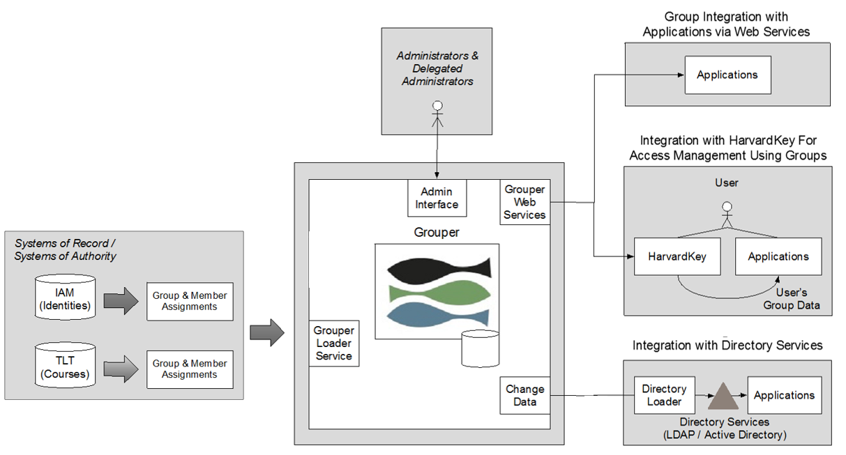
Groups Services Platform
Future
Notes:
Evolve and shape the service in response to demonstrated, prioritized needs
Grouper is central to the theme – envisioned over 3 years ago by principal architect Mahbub Rahman who maintains the current and future vision of the platform based on business need. let’s take a closer look at Grouper

Slide 7

Grouper
A group management system;
An open-source application provided by the Internet2 consortium; used widely among universities - https://www.internet2.edu/products-services/trust-identity/grouper/
Integrated with IAM identity and TLT course data so that group memberships are updated automatically
Used by school and department IT Service Providers to manage groups directly or via API for application authorization access
A web tool for delegated group administrators to manage groups for their local needs
Grouper is NOT directly accessible to faculty, staff and students at this time
Notes:
e.g. University of Chicago, University of Pennsylvania, Duke University
Part of their TIER initiative Trust & Identity in Education & Research
Although we’re late to the party, integrated with our centralized identity registry is something unique among participating universities.

Slide 8
Current Status of Grouper - Monthly Group Services Metrics
Approximately 290,000 groups in the system
  Reference groups (400+) - automatically update based on current roles/affiliations in IAM Identity Registry
  Academic Course groups (285,000+) - automatically update from Academic Technology course database
  Managed groups (100+)– ad-hoc or custom groups created and managed by IT Service providers for application-specific needs
  Application Authorization groups – (14) applications using Group Services for Authorization e.g. AWS, Talent Gateway, Lynda, Huit-Slack, Poll Everywhere, OpenScholar, Wiki
Limited distribution of the Grouper UI
  Delegated Group Administrators (125+) trained by IAM
  Group Membership Managers (30+) self-service guide
Notes:
Here are the basics:
Grouper is a platform (open source) that we have started to build on
We have implemented reference groups that IAM calculates
The platform is supporting delegated administration of groups
AT, AWS, others are integrated via an API and are creating groups
There is a user interface, and we are starting to support Delegated Admins using the Ui to create groups
Re: Course Group - Academic Tech database contains data from multiple sources: my.harvard provides us data for six of the schools (FAS, HKS, HDS, GSE, HSPH, GSD), and we get data from the rest of the schools directly.
Metrics -https://iam.harvard.edu/files/iam/files/group_services_metrics_report_jan2018.pdf

Slide 9
The Value of Reference Groups
Reference groups are automatically updated daily based on the system of record feeds to IAM and TLT
Using reference groups, you get “only current members” and this supports authorization objectives
By intersecting reference groups with your own managed (custom) groups, you can ensure that the membership of your managed groups are automatically updated to remove people who are no longer active
My team
All Employees
Resultant Group has only Active Employees on My Team

Slide 10
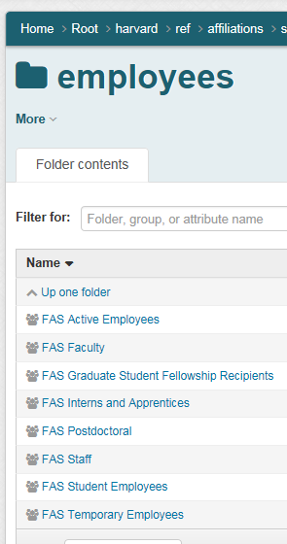
Reference Groups Build-out
Reference groups are automatically updated daily based on the system of record feeds to IAM and TLT
Today reference groups are only built out to the school – high level department depth
We have 400+ reference groups available today
Additional reference groups are built out upon request (e.g. at the department level)

Slide 11

HarvardKey Integrated with Group Services
Application Authorization Filter –
  After authentication, HarvardKey checks if the person is in a particular group, e.g., authorized-users-omni. If so, then access to the application is granted.
MemberOf Group Attribute Release –
  CAS or SAML release the groups a person is a member of in their response back to the application. The application then determines what to do with that information. Can be used for more granular level of permissions, e.g. standard or superuser permission.
Used for web-based application using CAS or SAMLs protcols.
The two methods which can be used alone or together.
Each requires one-time process: IAM setups up Application Authorization groups in Grouper and adds one or both methods to the application’s HarvardKey integration.

Slide 12
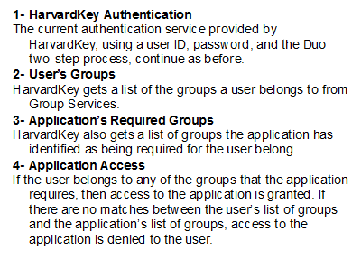
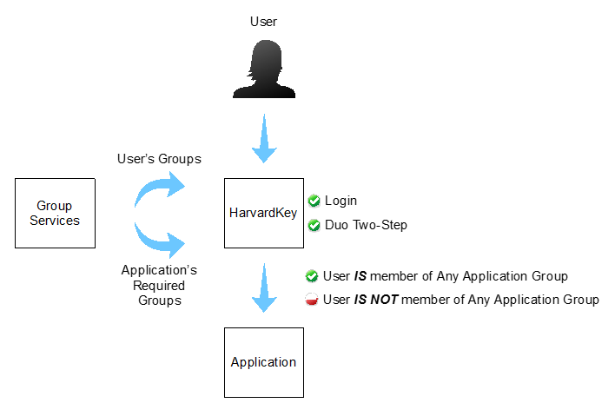
Application Authorization Filter - Key Features

Slide 13
Application Authorization Filter - Sequence Diagram

Slide 14
MemberOf Group Attribute Release - Key Features
Provides User’s Group Memberships to Applications

Slide 15
MemberOf Group Attribute Release - Sequence Diagram

Slide 16
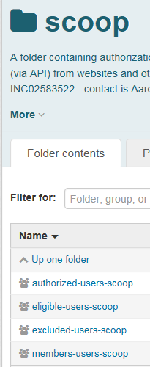
Application Authorization Groups
A set of group s which are used to derive one resultant group whose members are authorized to access an application.
Authorized-users = final resultant group after subtracting excluded-users from eligible-users (eligible-excluded)
Eligible-users = resultant group intersecting members-users with a reference group (members X reference group)
Excluded-users = list of people to exclude and the university excluded users group
Members-users = list of people, reference groups and or other managed groups who are the intended users of the application before removing inactive and excluded users.

Slide 17
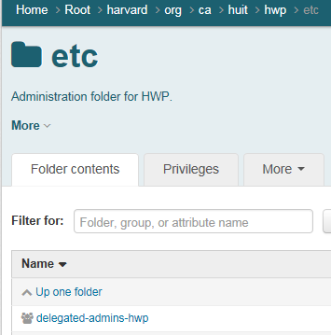
Delegated Group Administration
Grouper is ... designed for the highly distributed management environment and heterogeneous information technology environment common to universities [Internet2].
Delegated Group Administrators
Interacts directly with Grouper to set up sub-folder structure, and to create and manage groups
Receives training and observes IAM group conventions
Provides Tier 1 support for their school/department
May designate additional delegated administrators
Schools/Departments should designate an point-person to interact with IAM Group Services
Notes:
According to Internet2 this is the beauty of Grouper. Our architect Mahbub Rahman, says this is why we chose it. There were options….

Slide 18
How Can I Use The Service?
Group Service | How To Use The Service
Access Control for Web Applications using HarvardKey and Groups | IAM_help@harvard.edu Submit a request to integrate an application with HarvardKey. Submit this form with your request: http://iam.harvard.edu/files/iam/files/cas-saml-spusagerequest-form.pdf
Delegated Group Administration | IAM will provide consultation, training and onboarding for you to manage groups as you need. Submit your request to iam_help@Harvard.edu. Requests are managed by the IAM Accounts team and Group Services Owner, Terry Connolly at terry_connolly@harvard.edu
Need Groups? | Contact the delegated group administrators for your school/department at https://harvard.service-now.com/ithelp?id=kb_article&sys_id=f8b58eb2db7e4304a914fff31d9619aa on the IT Help Knowledge Portal.

